Slide 1
Capybara Cafe
Double Booking Nightmare

Slide 2
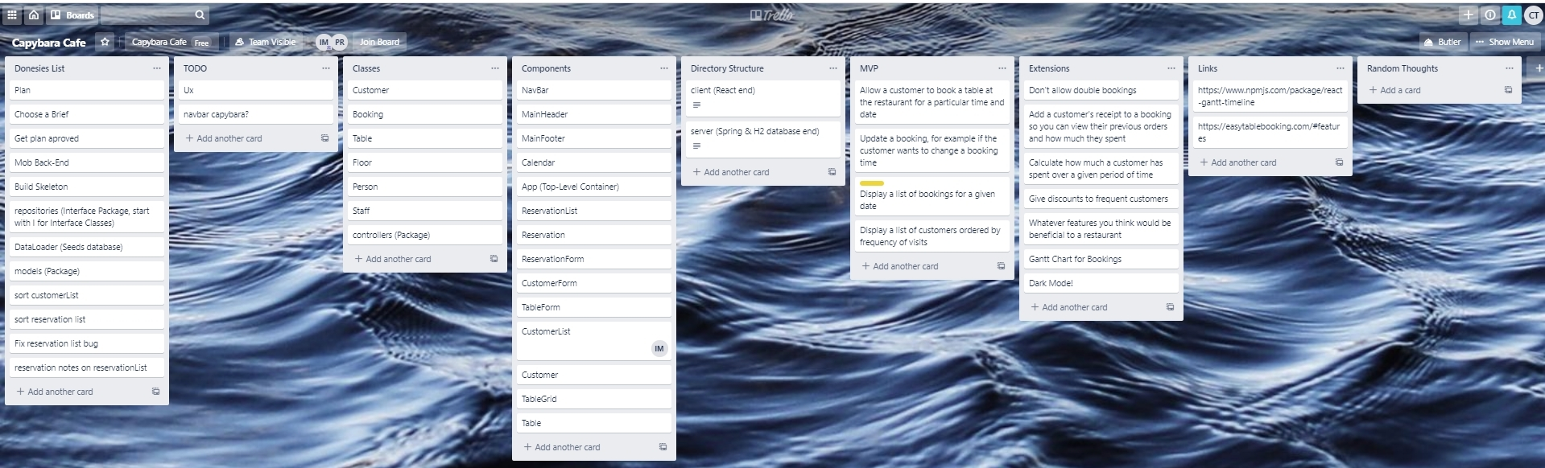

Slide 3
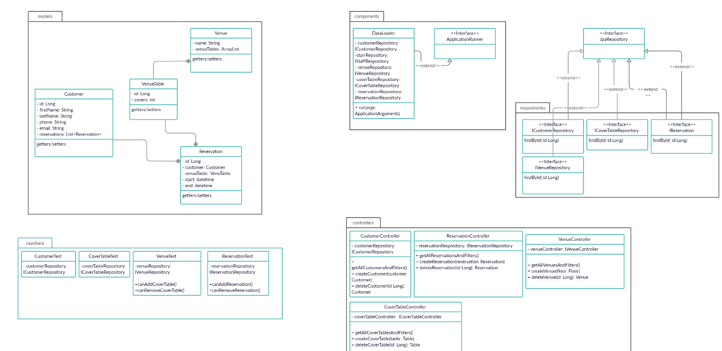

Slide 4
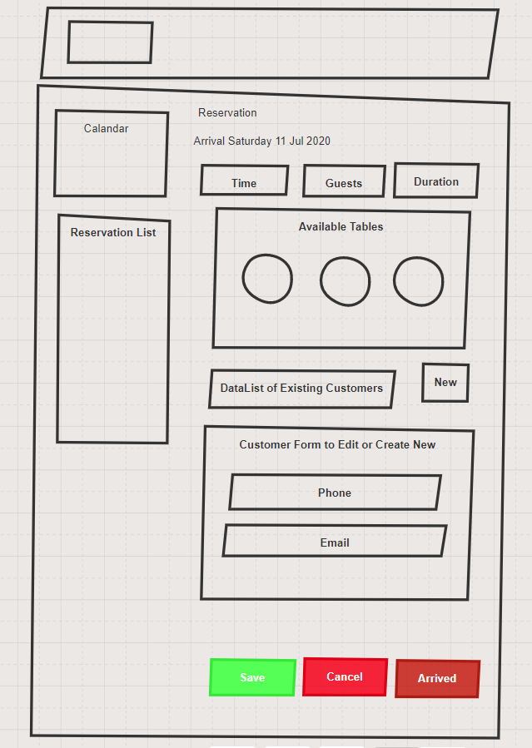

Slide 5
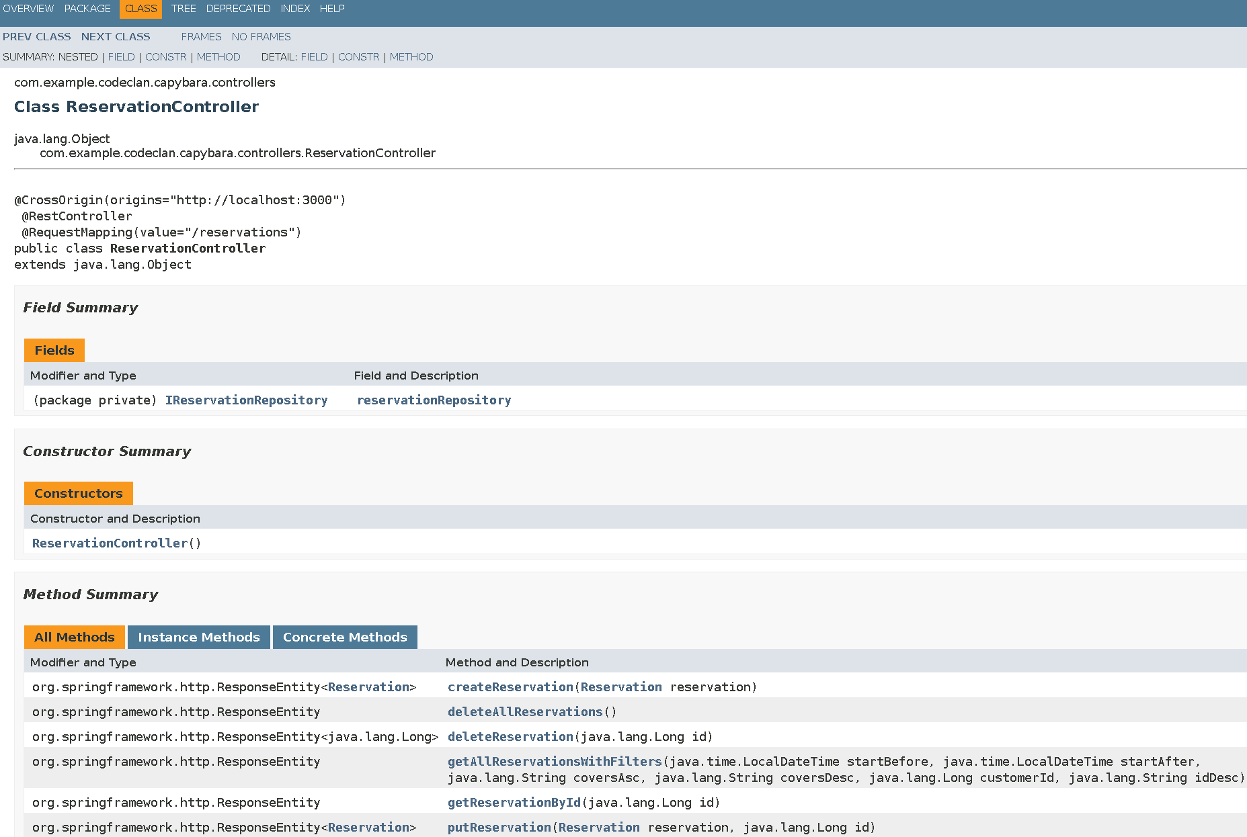

Slide 6
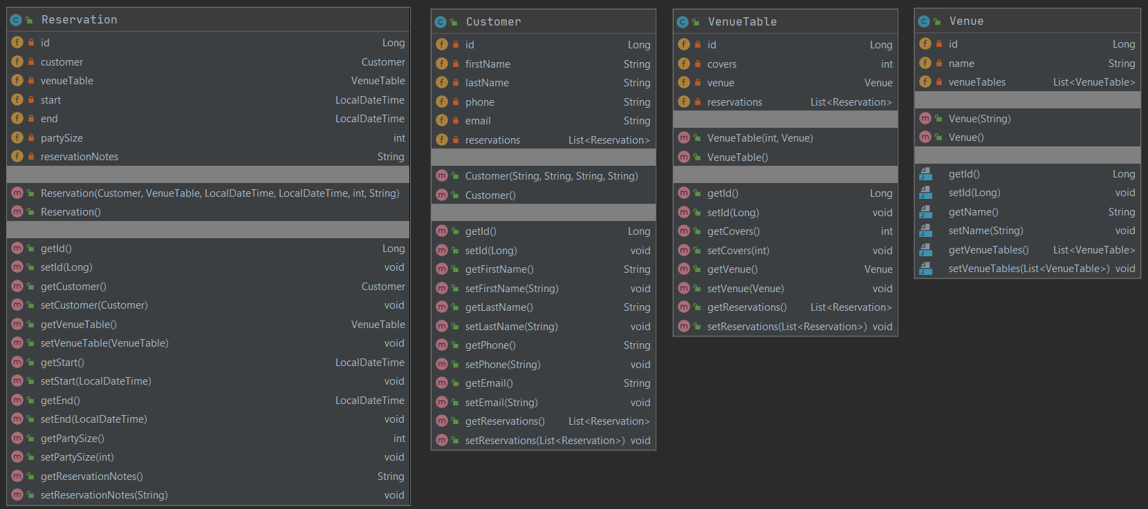

Slide 7
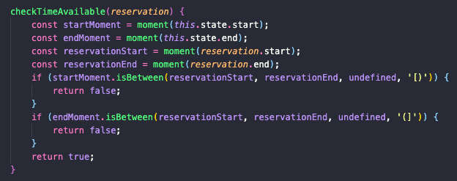

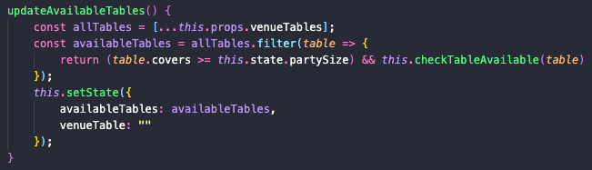
Checking Availability

Slide 8
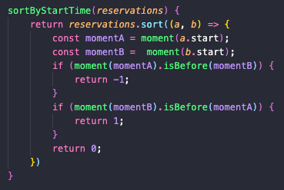

Sorting

Slide 9
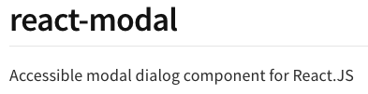
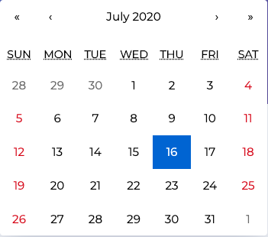


Slide 10

Demo
Capybara Cafe

Slide 11
What We Could Of Done Better
More planing more often
What we are proud of
The Whole App
The resilience and perseverance we had to deal with react

Slide 12
The End
Feel free to ask Questions

